Slide 1





CRM Analytics
DA_P1258 CRM Analytics Project by
Group 2 – Pallekonda Kiran and Kritika Rajesh Keoti
Tools used : Excel, Tableau, PowerBI and SQL

Slide 2
Project Objective
To analyze CRM data for leads and opportunities.
To track conversion and performance.
To identify trends over time and improve decision-making.
To understand distribution of leads and revenue on basis of sources, industries, stages, etc.
To create interactive dashboards using Excel, Tableau and PowerBI.
To use SQL queries for KPI calculation.

Slide 3
KPIs for Lead Dashboard
Total Leads – Total number of leads generated.
Expected Amount from Converted Leads – Total expected revenue from leads that have been converted.
Conversion Rate – Percentage of leads that are converted out of the total leads.
Converted Accounts – Number of leads that have been converted into accounts.
Converted Opportunities – Number of leads that have been converted into opportunities.
Lead By Source – Distribution of leads based on their source.
Lead By industry – Distribution of leads across various industries.
Lead by Stage – Breakdown of leads across various stages of the funnel.
Trend Analysis – Shows how the number of leads changes over time.

Slide 4
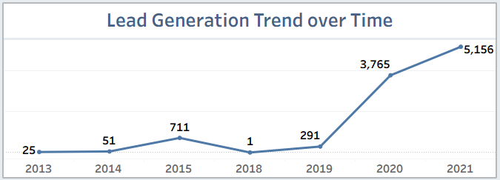
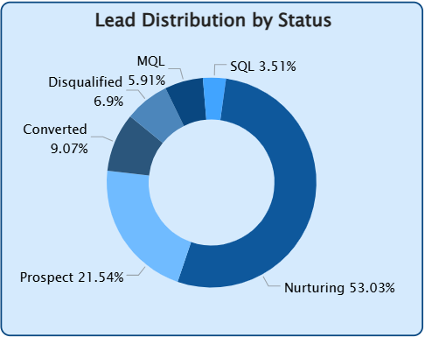
Lead data Visualizations
This line chart shows growth of leads generated across the years.
Highest lead generation is seen in 2021.
In this visualization, status distribution helps track the progress of leads.
Leads are spread across different stages of the process.

Slide 5
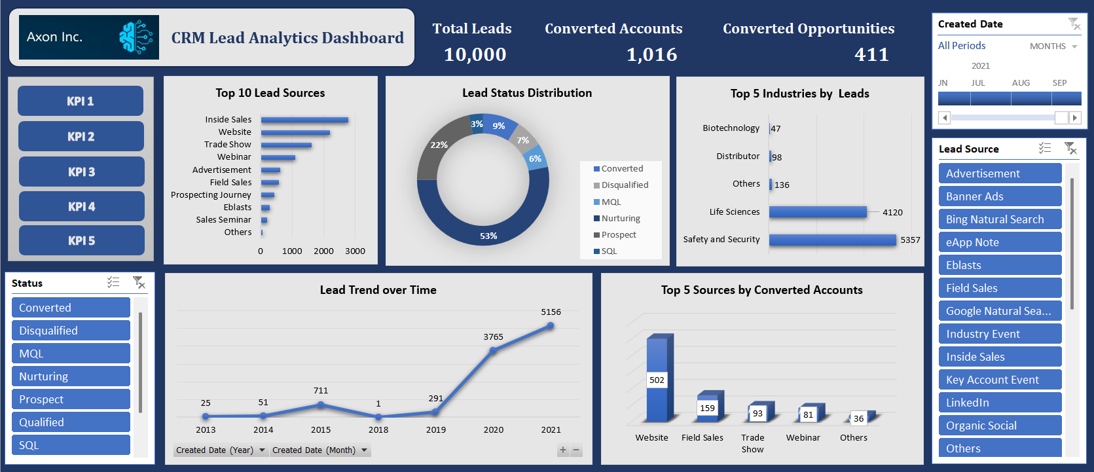
Lead Dashboard using Excel

Slide 6
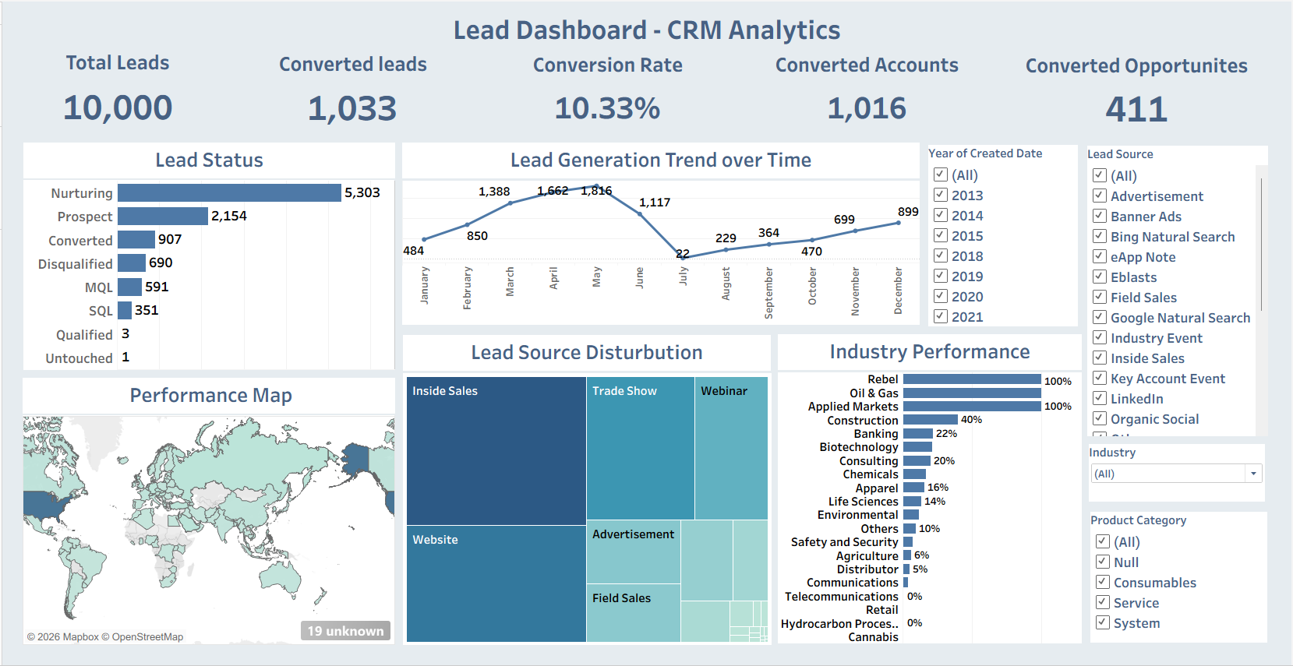
Lead Dashboard using Tableau

Slide 7
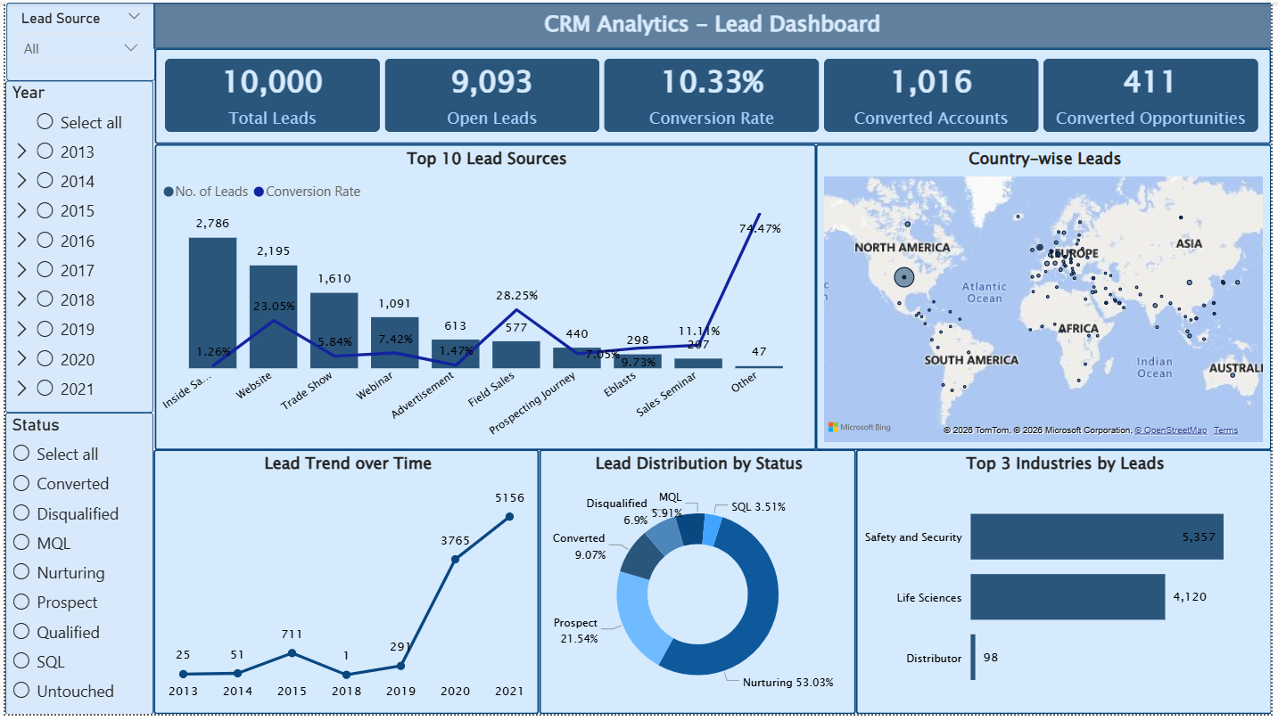
Lead Dashboard using PowerBI

Slide 8
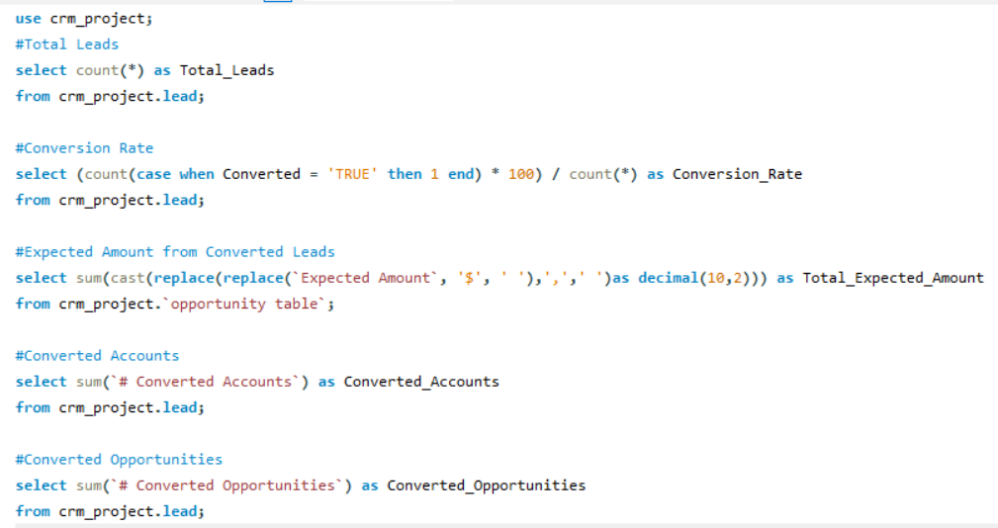
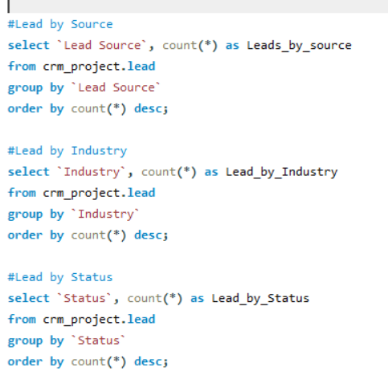
SQL Queries for Lead data KPIs

Slide 9
Key Insights from the Lead data analysis
Lead generation shows an increasing trend.
Conversion Rate is relatively low compared to total leads.
Inside sales and Website sources contribute more leads than others.
The Safety and Security industry generates highest number of leads, followed by Life Sciences.
Majority of leads are in the nurturing stage.

Slide 10
KPIs for Opportunity Dashboard
Expected Amount – Total expected revenue from all opportunities.
Active Opportunities – Number of open opportunities that are still in progress.
Win Rate – Percentage of opportunities that have been successfully closed as won.
Loss Rate – Percentage of opportunities that have been closed as lost.
Opportunities by Industry – Distribution of opportunities across various industries.
Expected vs. Forecast – Comparison between expected revenue and forecasted revenue.
Active vs. Total Opportunities – Proportion of open opportunities compared to the total opportunities.
Closed Won vs Lost – Comparison of opportunities successfully won with those that were lost.
Trend Analysis – Shows how opportunities or revenue changes over time.

Slide 11
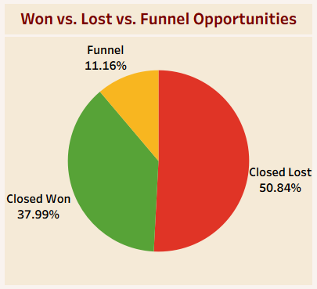
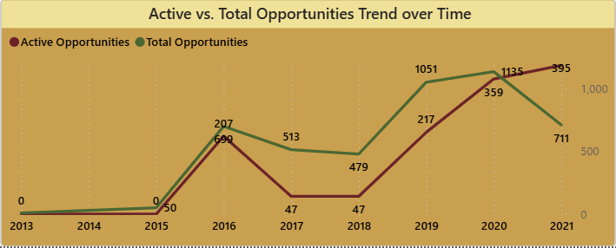
Opportunity data Visualizations
In this visualization, opportunities are distributed across won, lost and funnel stages.
Funnel stage shows opportunities that are still under process.
The chart helps compare overall opportunities with currently active ones.
Both active and total opportunities increased over the years.

Slide 12
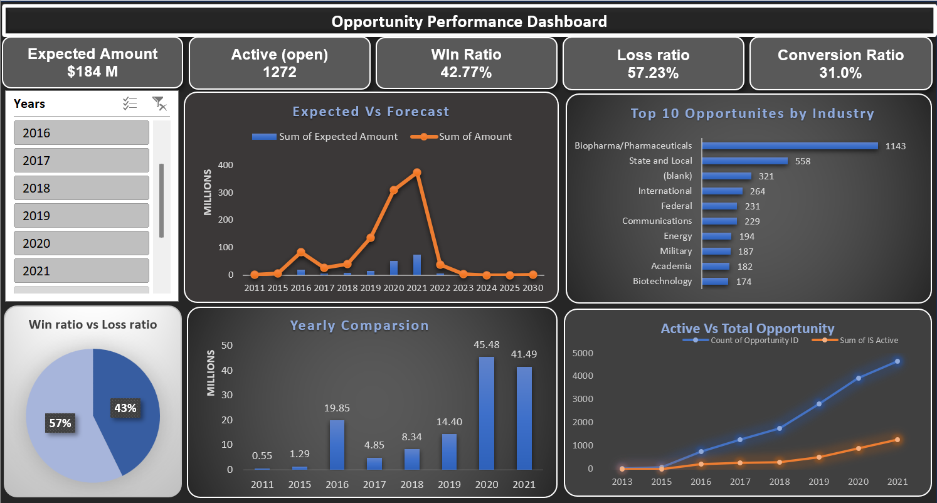
Opportunity Dashboard using Excel

Slide 13
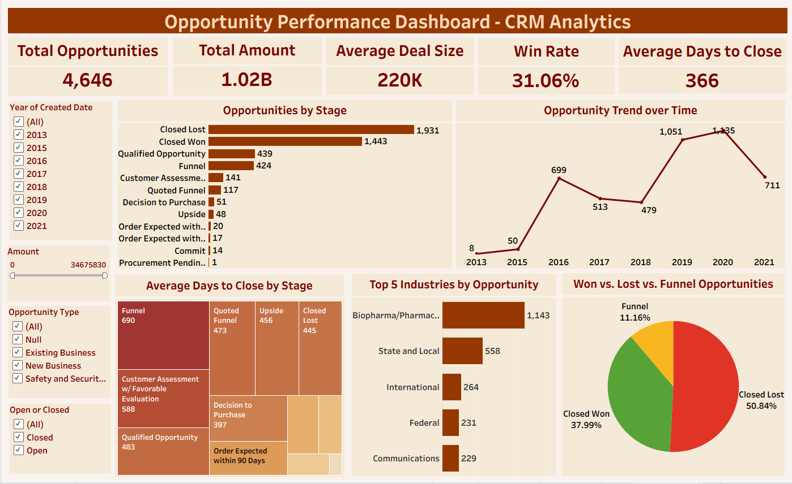
Opportunity Dashboard using Tableau

Slide 14
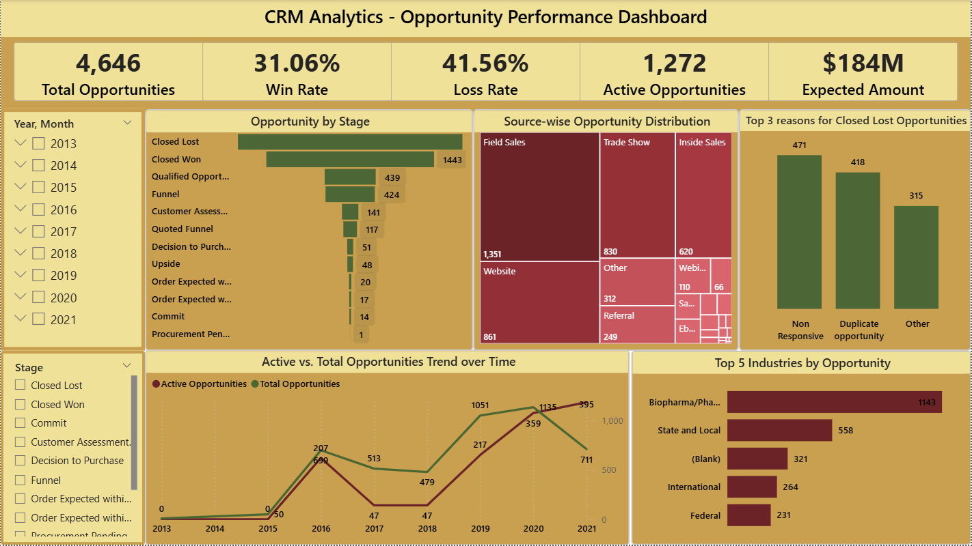
Opportunity Dashboard using PowerBI

Slide 15
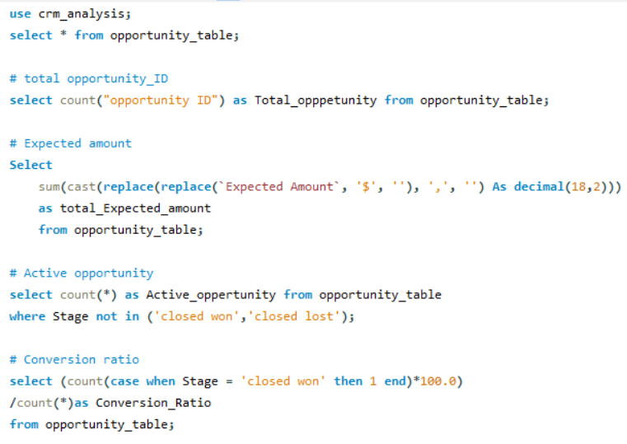
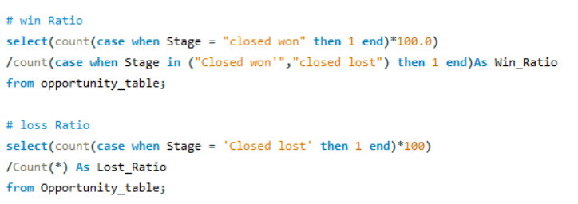
SQL Queries for Opportunity data KPIs

Slide 16
Key Insights from the Opportunity data analysis
Total expected amount is high.
Loss rate is slightly higher than Win rate.
The Biopharma/Pharmaceuticals industry contributes most to revenue generation.
Active opportunities are high, but progress through stages is slow.
Actual vs. Forecast gap shows prediction issues.
Opportunity trend shows steady growth over time.

Slide 17
Conclusion
This analysis project helps identify trends and patterns in lead and opportunity performance.
It also provides understanding of CRM data using key performance indicators, dashboards and visualizations for better business decision-making process.
Thank You!

